Slide 1

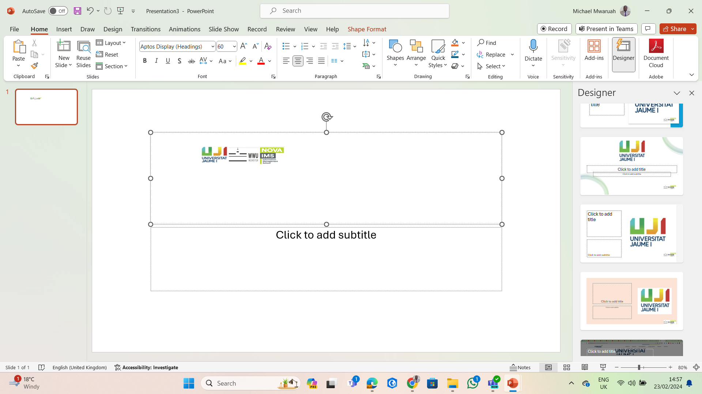
Sharing ML models using IoT Communities of Interest based on Data Similarity and Location.
NAME : MICHAEL SIRYA MWARUAH al427081@uji.es PROGRAM: MASTER IN GEOSPATIAL TECHNOLOGIES

Slide 2

Introduction
IoT stands for Internet of Things- devices that gather and share information over the internet.
The number of IoT devices is projected to reach 38.6 billion by 2025 and 50 billion by 2030
This Photo by Unknown Author is licensed under CC BY-SA

Slide 3

Context
Problem
Tradition methods- struggle to handle the sheer volumes and velocity of these amounts of data.
Solution
Artificial Intelligence/Machine learning can efficiently process and analyze massive IoT datasets in real time.
How?
recognize patterns and make predictions.
Enabling complex feature extraction and decision-making.
maintaining performance and accuracy.

Slide 4

Context
Problem
Creating ML models for the numerous different IoT devices is an expensive and difficult task.
Creating one big model for all the IoT devices is impracticable.
Solution
Find a way of sharing these ML models among IoT devices.

Slide 5

Motivation
To leverage the capabilities of AI/ML to turn IoT from mere data messengers to Autonomous decision makers.
Finding a way to share the AI/ML among IoT devices.

Slide 6
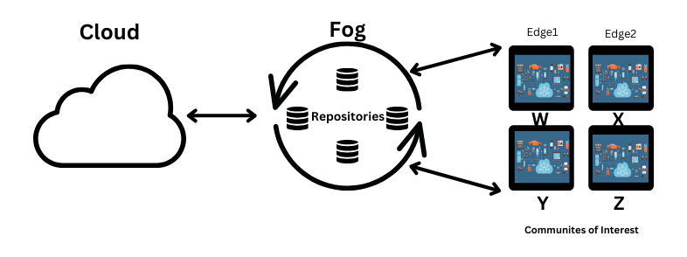
ARCHITECHTURE OF MAIN PROJECT

Slide 7
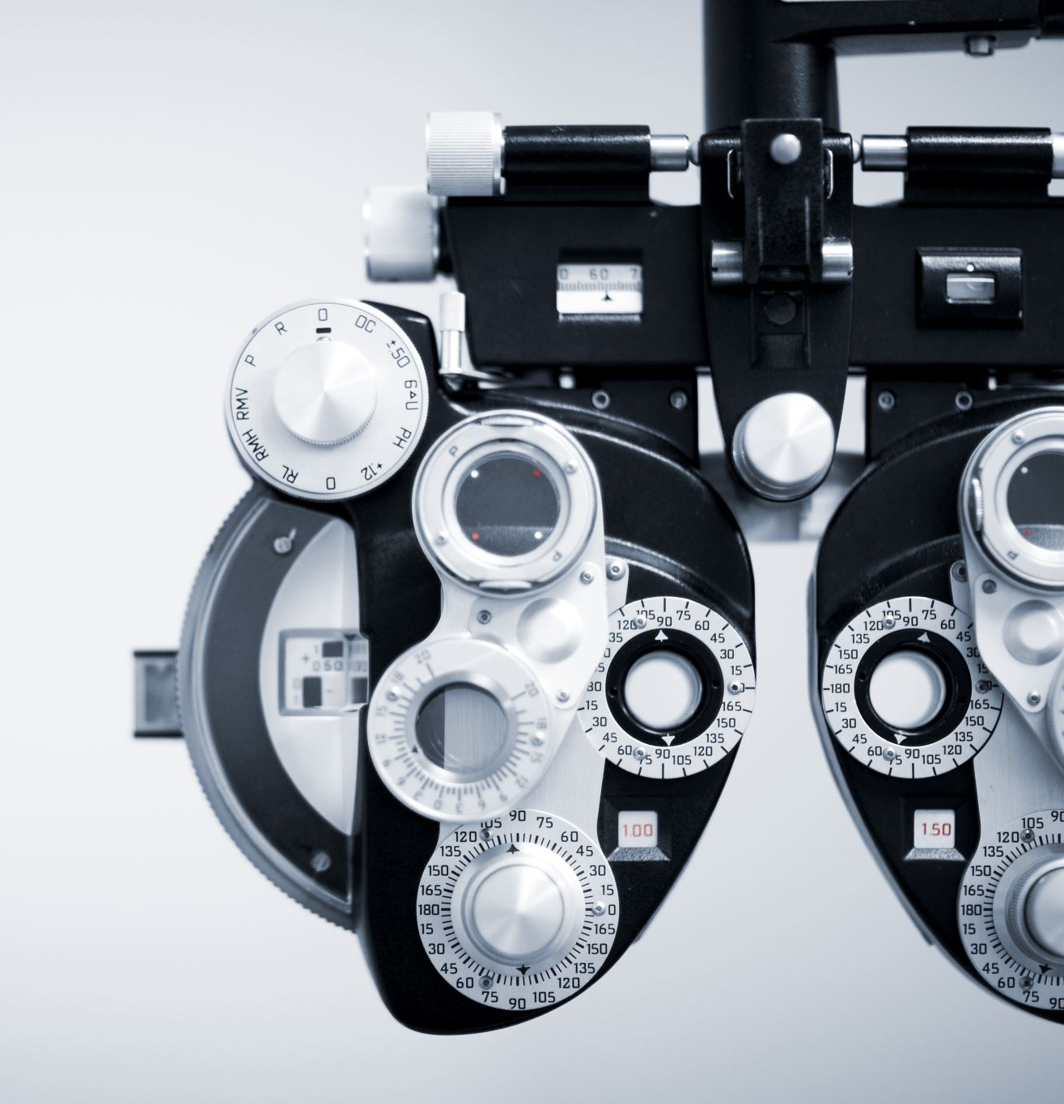
Main Objective
To leverage geospatial components to enable the sharing and re-use of pre-trained ML models among IoT devices.

Slide 8

Specific Objective
Following Communities of Interest establish geospatial zones based on the inherent similarity of IoT data streams.
Craft and validate ML models tailored to the unique characteristics of each geospatial zone.

Slide 9
Research Questions
Can IoT devices be grouped into Communities of Interest according to the similarity of temporal data and geospatial attributes?
Can grouping IoT devices into CoI based on their data similarity enable the sharing Tiny ML models among the devices?

Slide 10

Methodology and Analysis

Slide 11
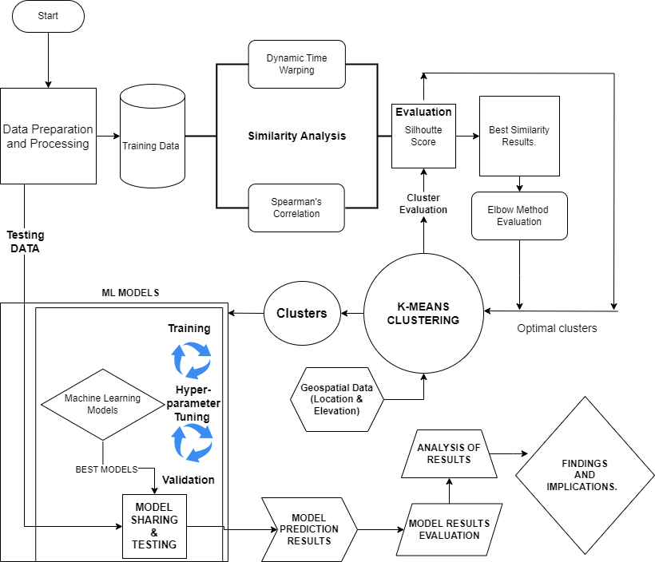

Slide 12
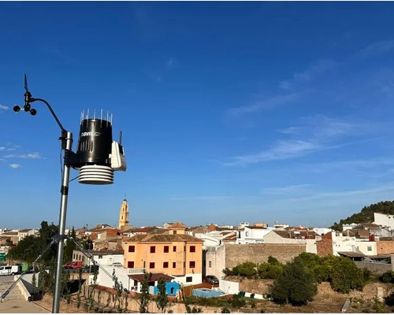
Data Set
Temperature Weather Sensor Data from Meteorological Association of Valencia.
Simulate Real World IoT Data Scenario.

Slide 13
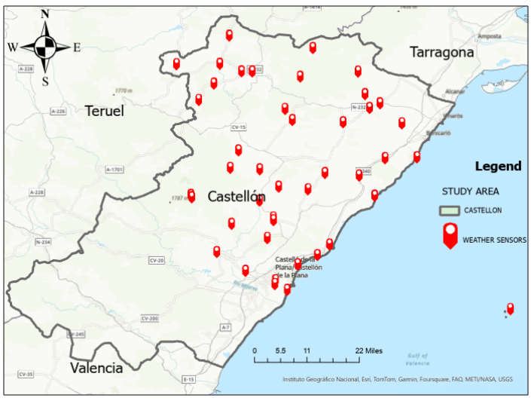
Study Area

Slide 14
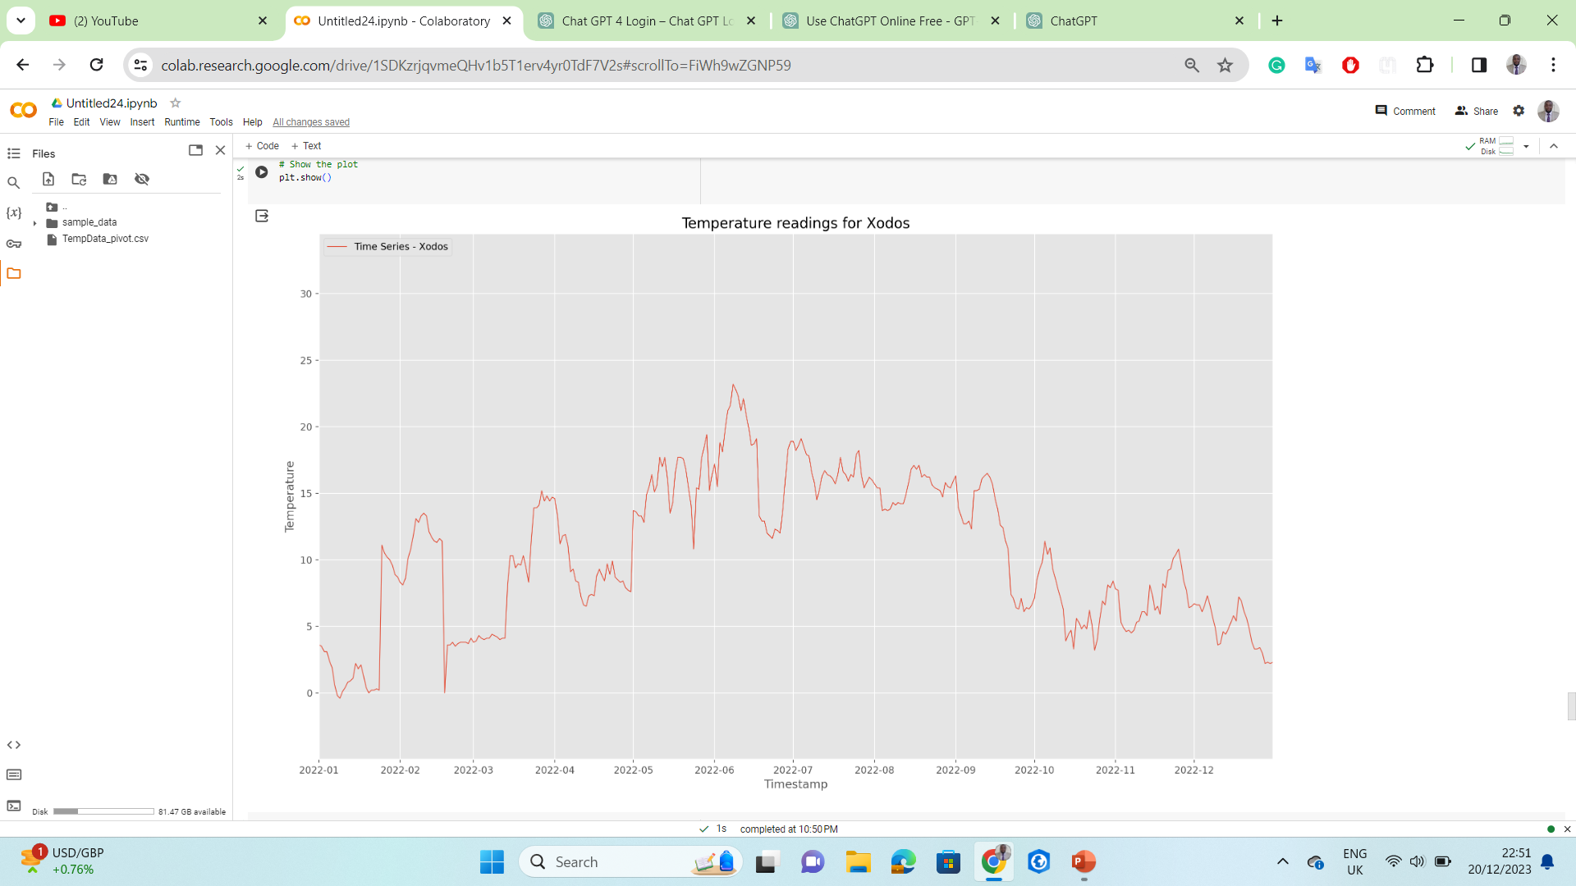
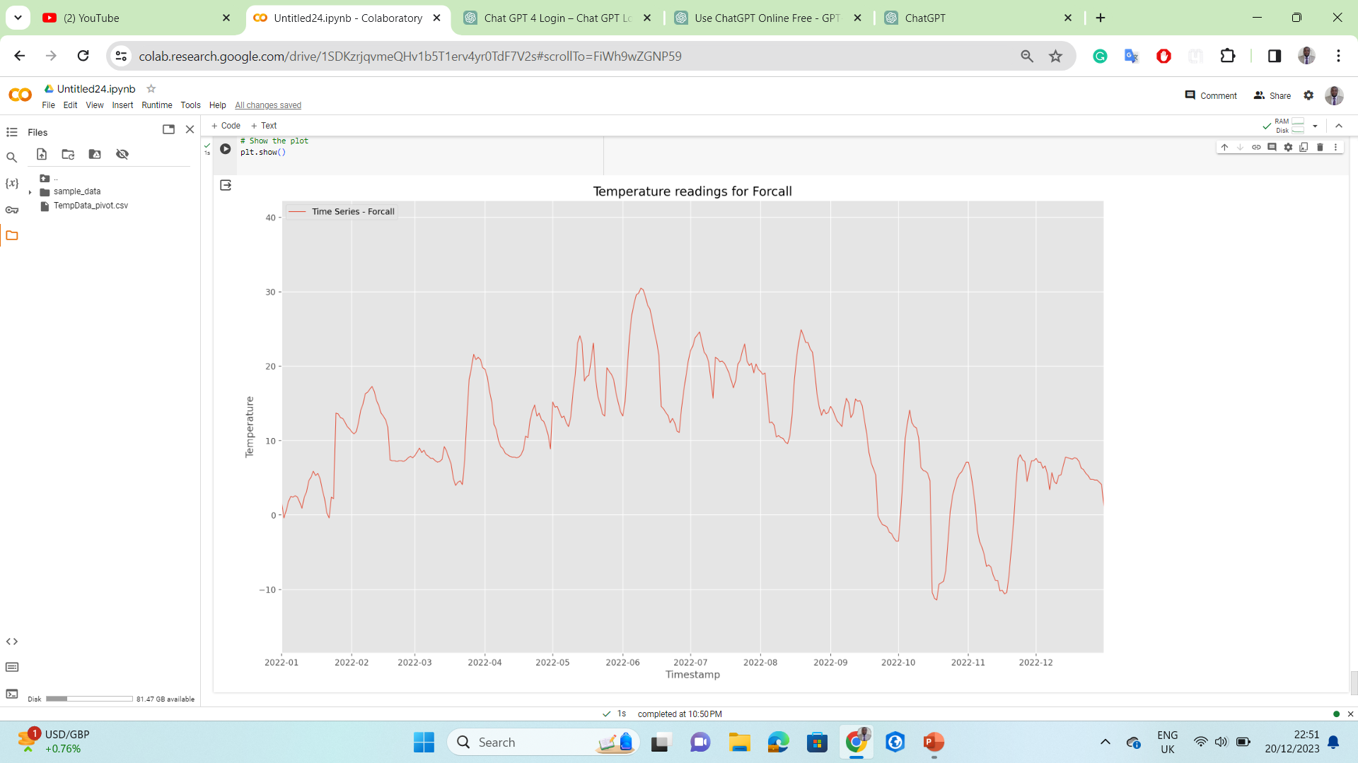
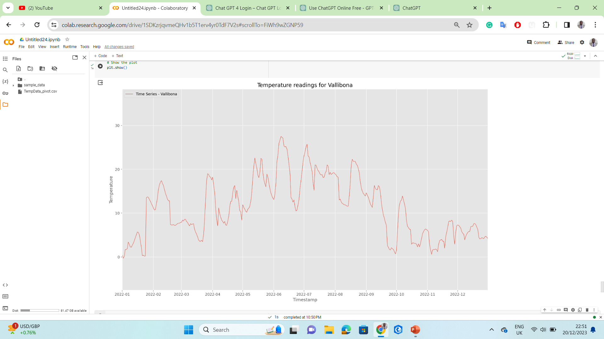

Slide 15

Time Series Similarity Analysis
Goal- determine the degree a time series resembles another one.
Why - valuable insights and enable the clustering of the sensors according to the similarity of their data.

Slide 16

Similarity Measure
Spearman’s Rank Correlation – statistical measure that evaluates monotonic relationships.
Monotonic relationships - variables tend to move in the same relative direction but not necessarily at a constant rate.

Slide 17
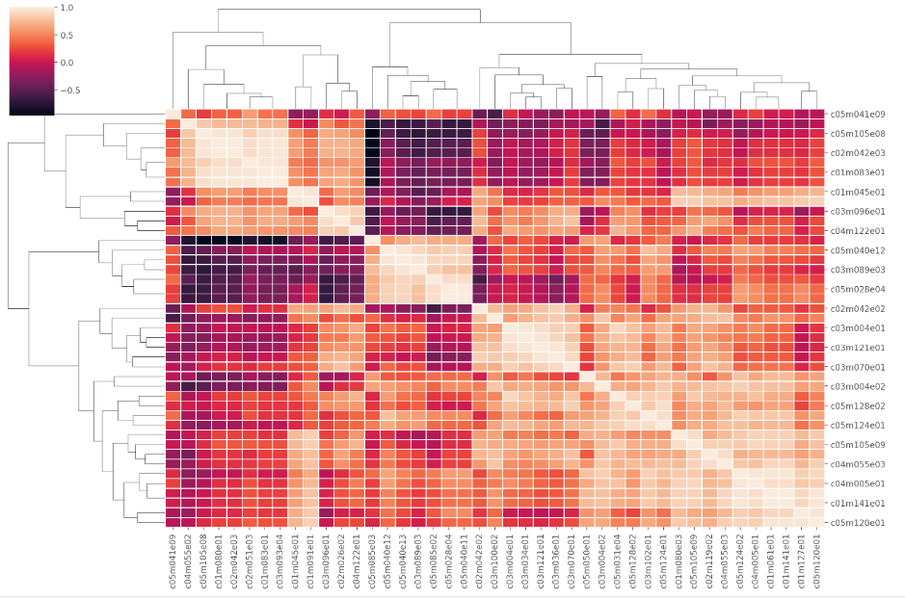
Correlation Matrix

Slide 18

Clustering

Slide 19

Clustering
process of identifying Similar groups within a Dataset.
Algorithm
used – K MEANS

Slide 20
Cluster Quality Analysis
Elbow Method
Silhoutte Score

Slide 21
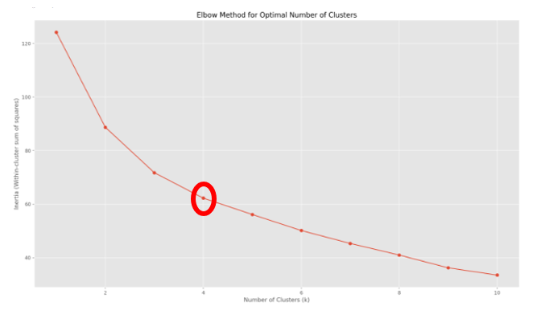
Elbow Plot for Optimal Cluster Number

Slide 22
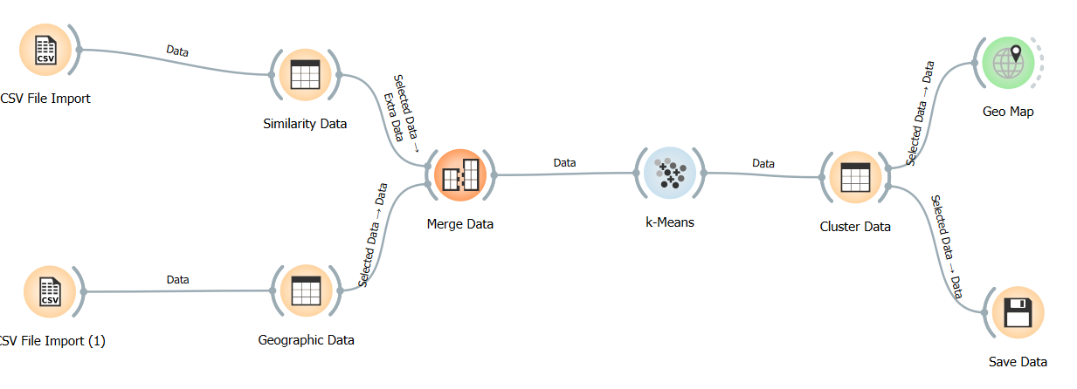
K-Means flow chart

Slide 23
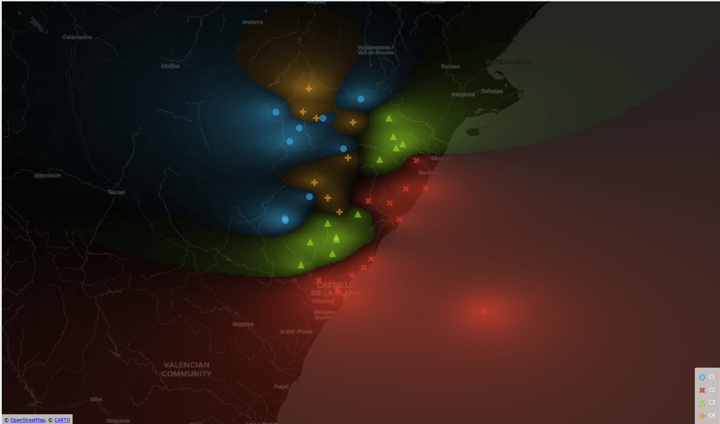
Communities of Interest

Slide 24
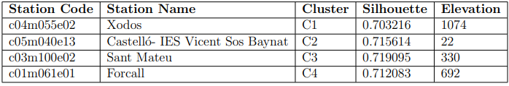
Training Data

Slide 25

Machine Learning Model Selection
Long Short-Term Memory.
Three Way Hold Out Validation .
Nested Cross Validation.
Random Forest Regressor
Nested Cross Validation
This Photo by Unknown Author is licensed under CC BY-SA-NC

Slide 26
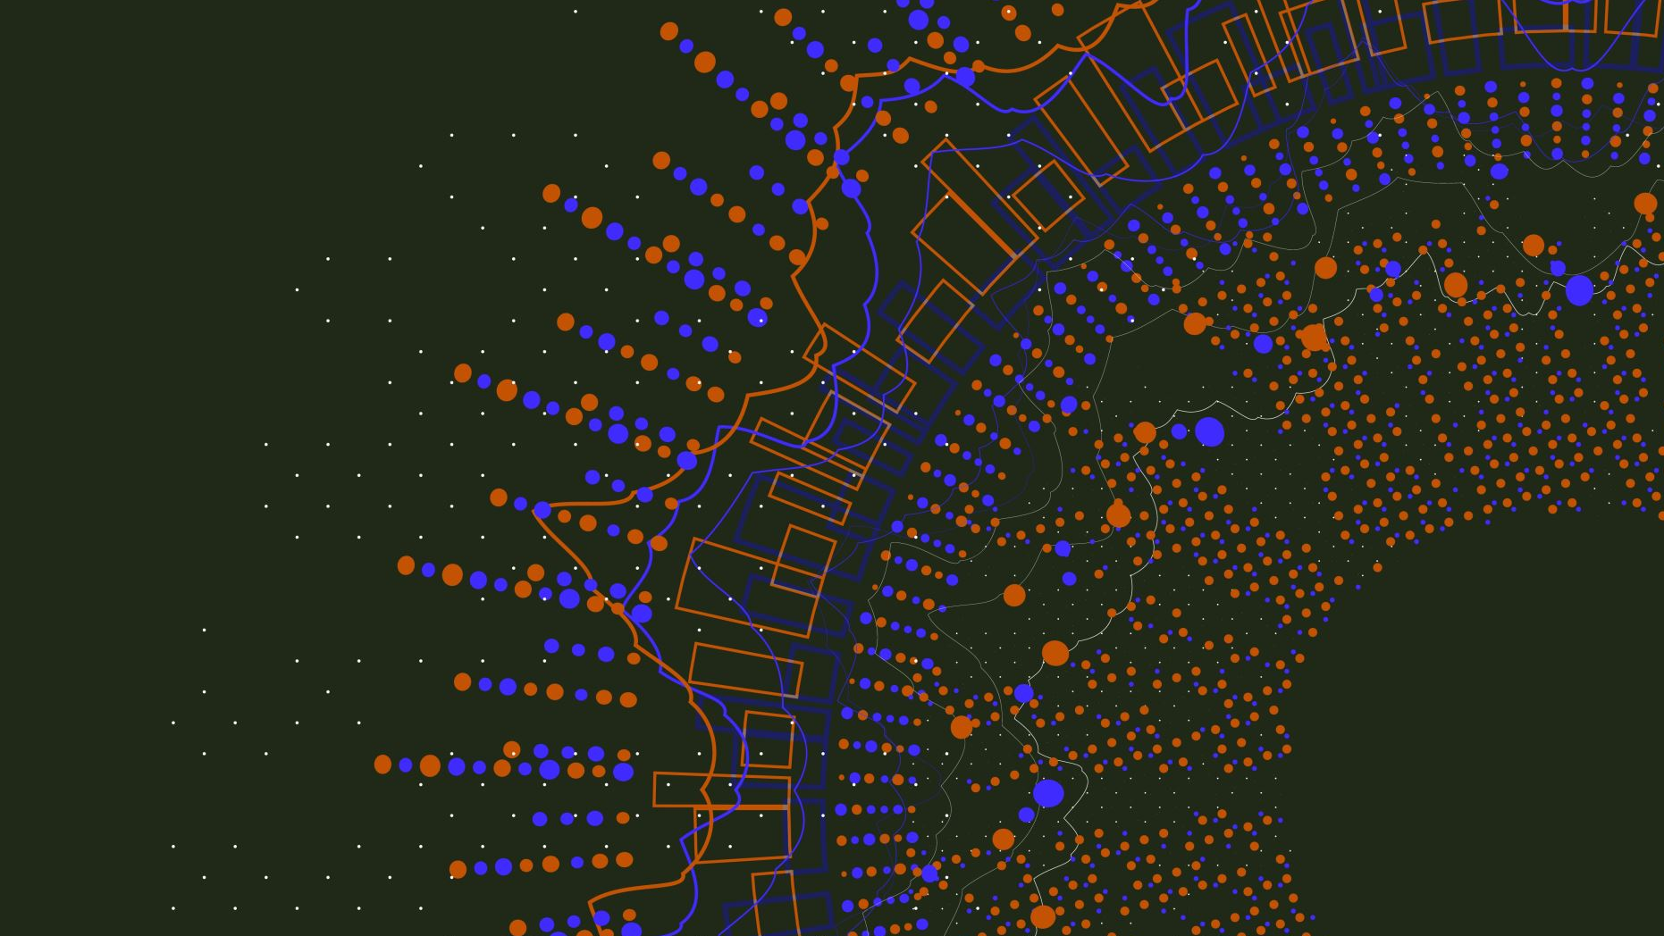
Machine Learning Model Selection
LSTM- recurrent neural network (RNN) architecture.
particularly well-suited for sequential data and time-series analysis.
excels in capturing patterns and relationships over extended sequences, thanks to their ability to selectively remember or forget information over time.

Slide 27
Machine Learning Model Selection
Random Forest- decision tree algorithms.
Versatile and robust, ability to handle complex datasets, maintain good performance with default hyperparameters, and mitigate overfitting.
Used for classification and regression tasks, and their inherent parallelism allows for efficient processing of large datasets.

Slide 28
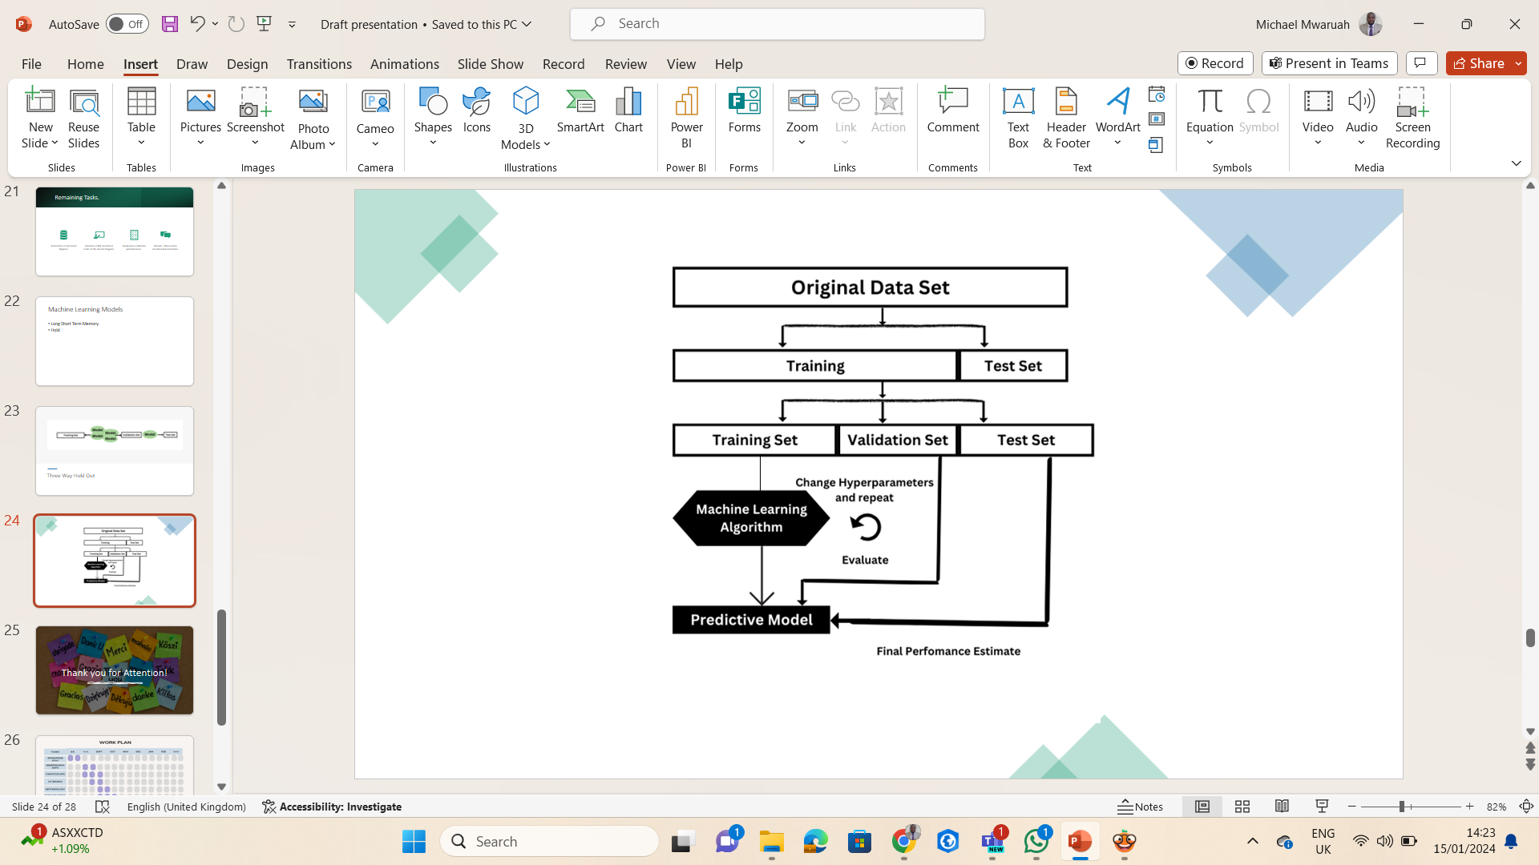
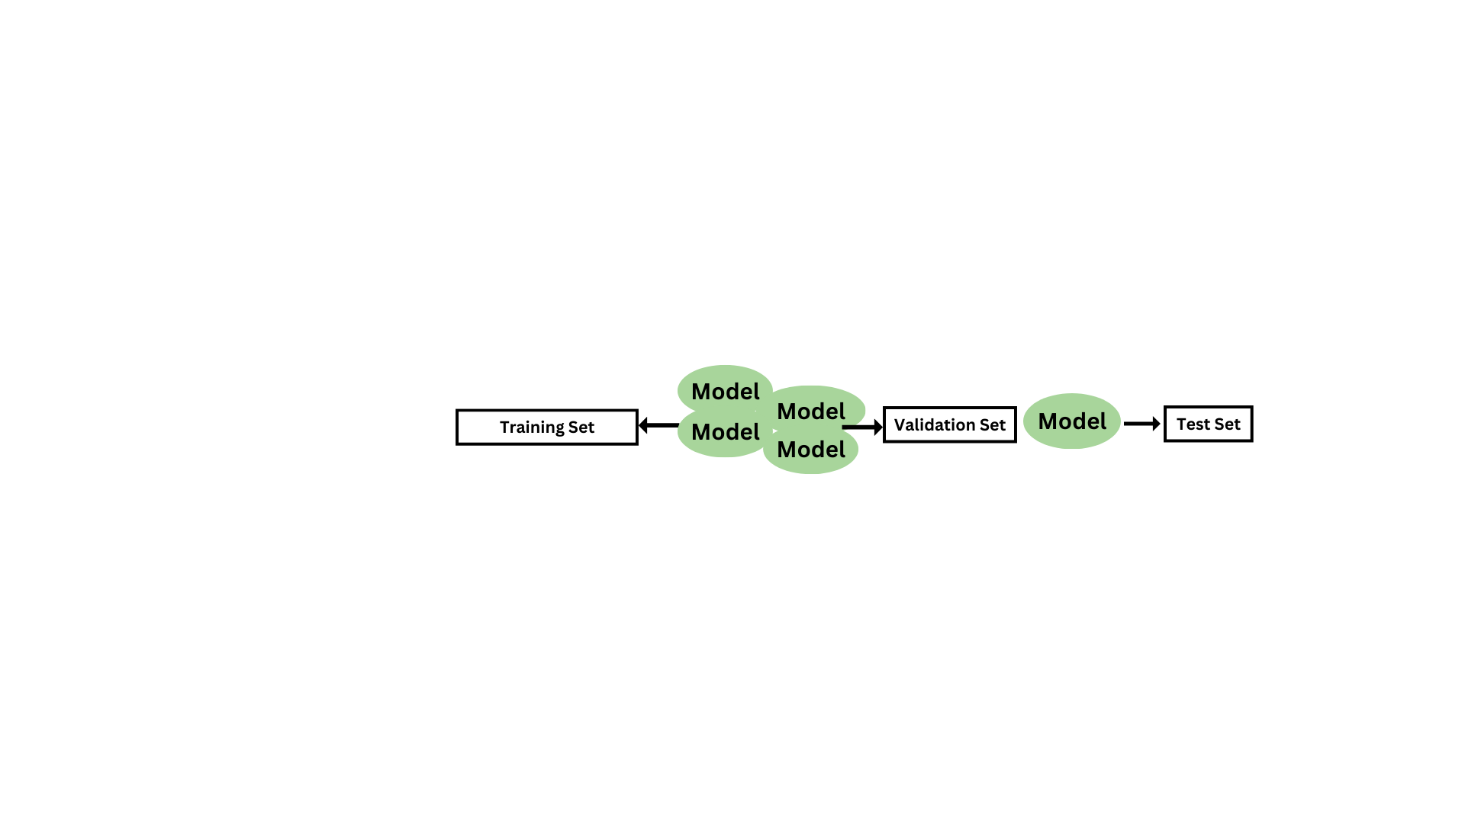
Three way Hold Out Validation

Slide 29
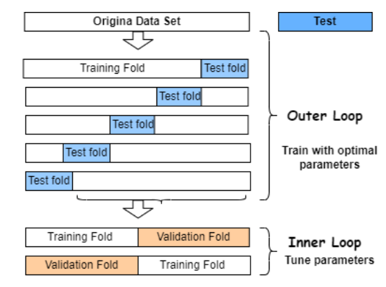
Nested Cross Validation

Slide 30
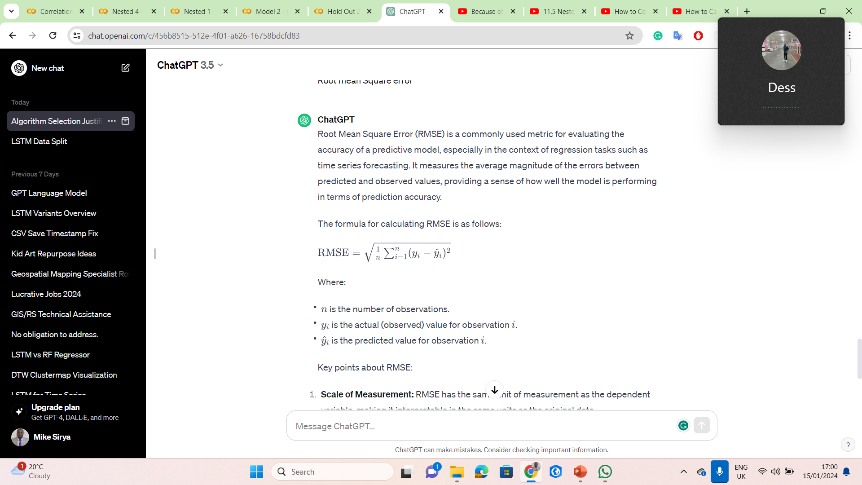
Model Performance Evaluation Metrics
Root Mean Square Error (RMSE) –
Evaluates the accuracy of a predictive model.
especially in regression tasks such as time series forecasting.
Measures average magnitude of errors between predicted and observed values.

Slide 31
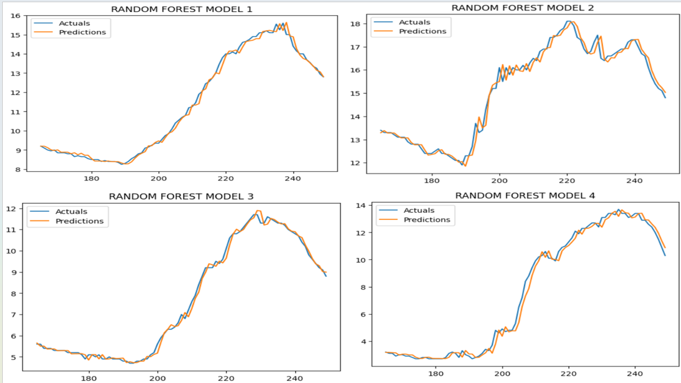
Performance Evaluation

Slide 32
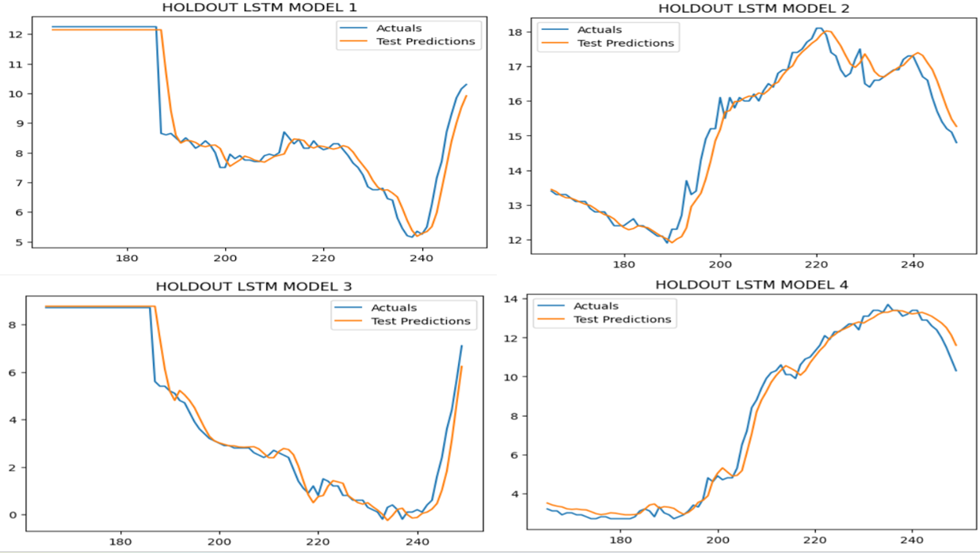
Performance Evaluation

Slide 33
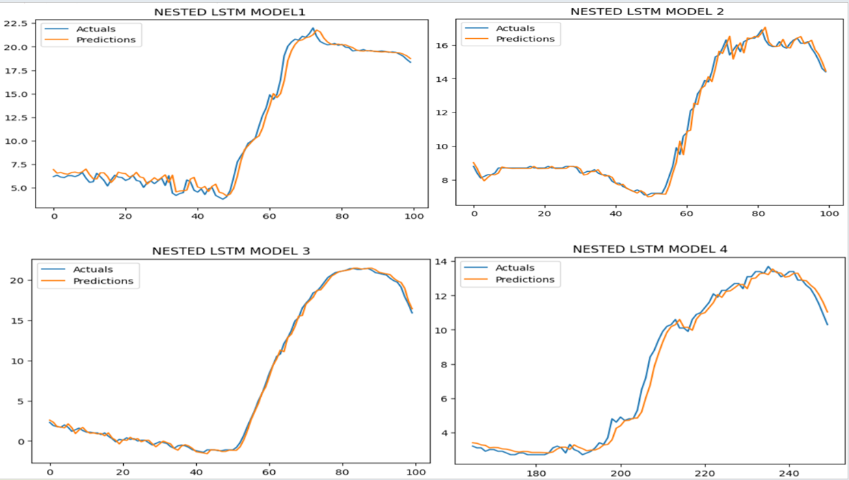
Performance Evaluation

Slide 34
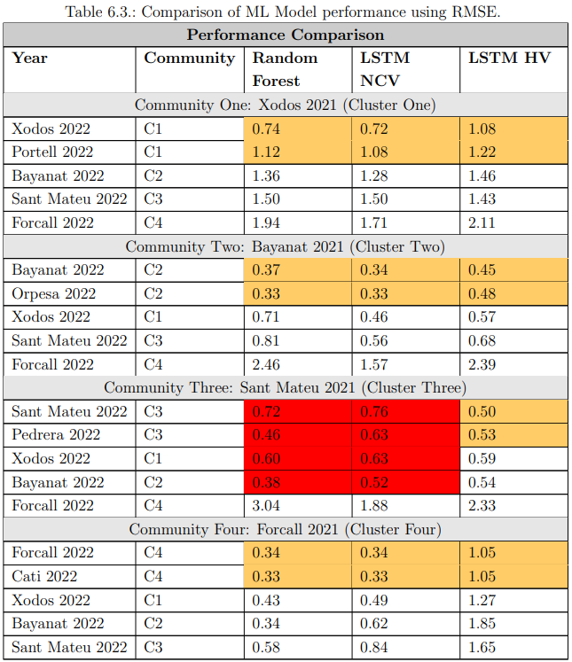

Slide 35

Clustering sensors based on the similarity of their sensor data and location - leads to improved (RMSE) for predictive models.
Specifically, models trained and tested within the same cluster (CoI) show a notable reduction in RMSE.
Models trained on sensors from other clusters generally perform poorly when tested on sensors from different CoI.
Grouping IoT devices into CoI based on their data similarity is an ideal method for the sharing of ML models among the devices.
This Photo by Unknown Author is licensed under CC BY-SA

Slide 36

Why?
Leads to Lower RMSE which translates to a higher prediction accuracy.

Slide 37
Limitations
Experiment did not progress to creation of TinyML to test in Real world IoT devices.
Dataset may not fully capture the complexities of IoT.
Method’s effectiveness relies on specific assumptions and parameters, which may not always hold true in practical deployment scenarios.

Slide 38

Benefits
Generalization and Transferability- It is applicable to a broader range of devices and locations.
Reduce costs
Adaptability -more resilient to changes in the environment or variations in device characteristics.
Faster Deployment: faster and more streamlined than deploying individual models for each device.
Simplified Maintenance: single shared model can be more straightforward than managing multiple models for individual devices.

Slide 39
Recommendations/Future Work
Development of an automated recalibration system for clusters driven by real-time data to enhance adaptability of ML models
Exploration of tinyML models on real-world IoT devices using TensorFlow Lite for efficient deployment on resource-constrained devices
Incorporation of a location-centric pre-trained model service to customize models for specific geographic regions

Slide 40
Recommendations
Establishment of centralized and decentralized model repositories for collaborative sharing within the IoT community, facilitated by a web service
Broaden research scope to applications beyond temperature prediction, such as healthcare diagnostics, image recognition, and natural language processing.
Real-world testing with mobile IoT devices in dynamic environments to assess adaptability and efficacy of ML-sharing approach.

Slide 41

Questions?!

Slide 42

Thank you for your Attention!
MICHAEL SIRYA MWARUAH
al427081@uji.es

